Slide 1
Chapter 4 Dynamic Programming
Intro to Reinforcement Learning
By Richard Sutton

Slide 2
Dynamic Programming
Algorithms to compute optimal policies with a perfect model of environment
Use value functions to structure searching for good policies
Foundation of all methods hereafter
Monte Carlo
Dynamic Programming
Temporal Difference

Slide 3
Dynamic Programming
Policy Evaluation
Policy Improvement
Value Iteration
Assumes full knowledge of MDP

Slide 4
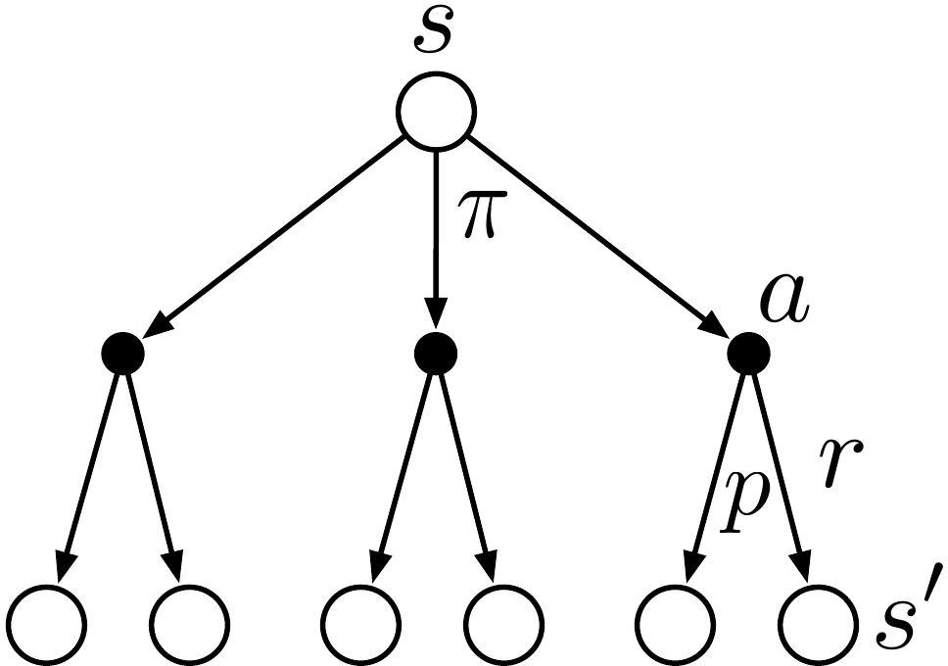
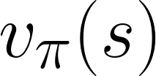

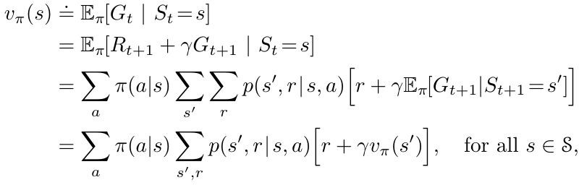
Policy Evaluation (Prediction)
Compute state-value for some policy
Use the Bellman Equation:
Notes:
value function for a given policy pi. Could be random or greedy or whatever.
at a given state.
look at all actions, with policy.
what is the probability of going to the next state, getting a reward with the given action.

Slide 5

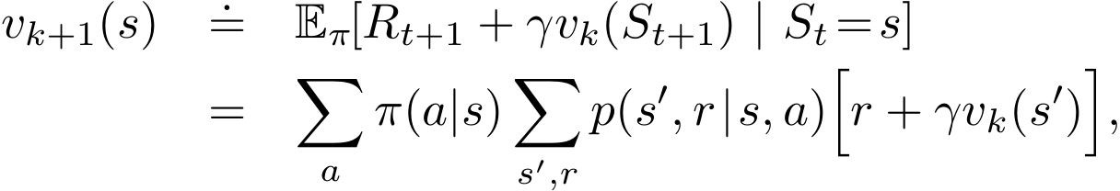
Iterative Policy Evaluation
Solving linear systems is tedious → Use iterative methods
Define sequence of approximate value functions
Expected update using the Bellman equation:
Update based on expectation of all possible next states
Notes:
here we improve the value function iteratively and it is proven to converge to v_pi

Slide 6
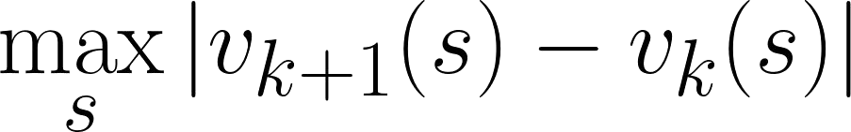
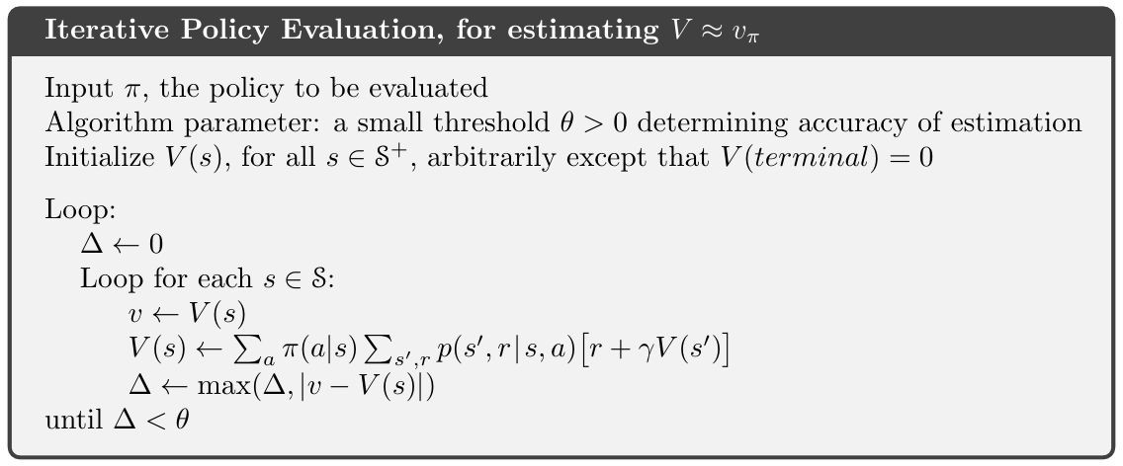
Iterative Policy Evaluation in Practice
In-place methods usually converge faster than keeping two arrays
Terminate policy evaluation when is sufficiently small

Slide 7
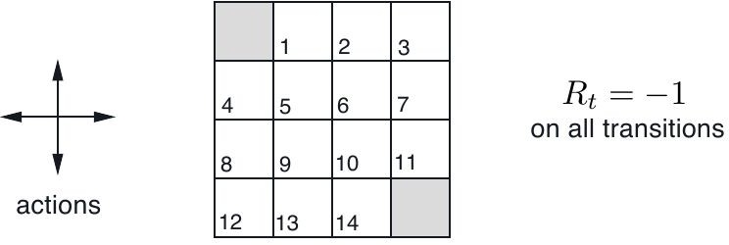
Gridworld Example
Deterministic state transition
Off-the-grid actions leave the state unchanged
Undiscounted, episodic task

Slide 8
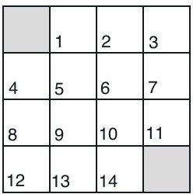
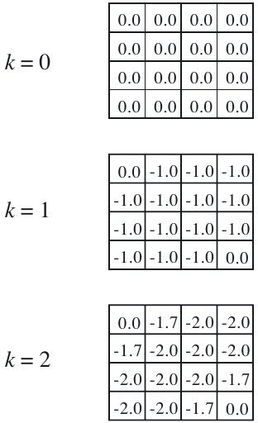
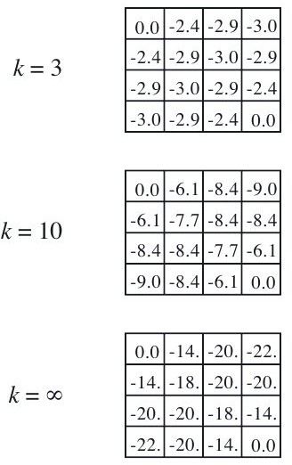
Policy Evaluation in Gridworld
Random policy

Slide 9


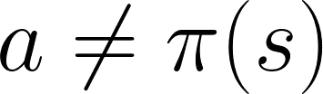
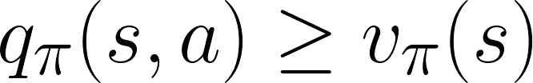

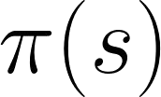
Policy Improvement - One state
Suppose we know for some policy
For a state , see if there is a better action
Check if
If true, greedily selecting is better than
Special case of Policy Improvement Theorem
0
 | 0
-1 |  |  | -1
 | -1
-1
-1
-1

Slide 10
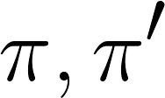

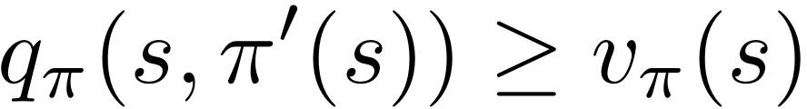

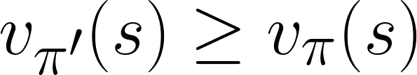
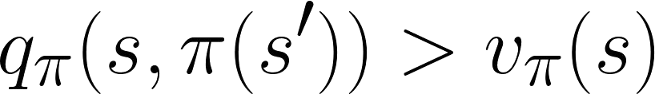
Policy Improvement Theorem
For policies , if for all state ,
Then,
is at least as good a policy as .
(Strict inequality if
)

Slide 11
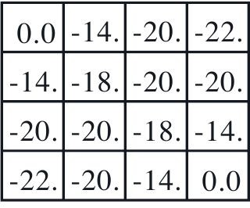
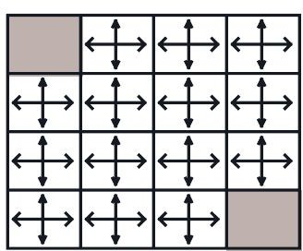
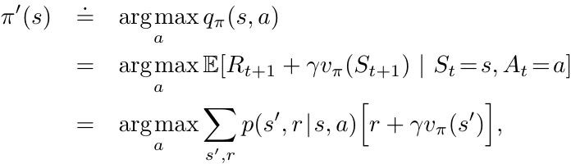
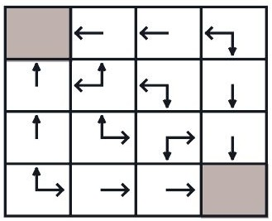
Policy Improvement
Find better policies with the computed value function
Use a new greedy policy
Satisfies the conditions of Policy Improvement Theorem

Slide 12
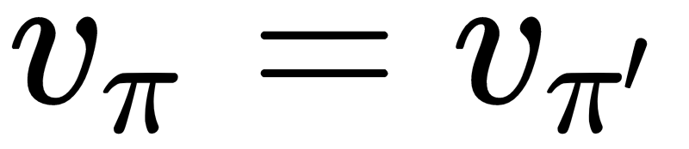
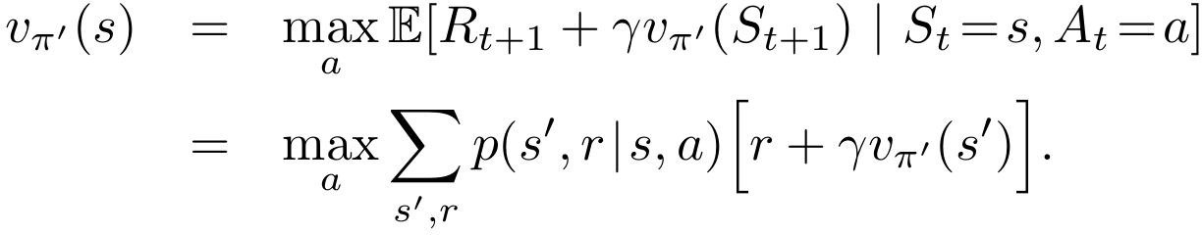
Guarantees of Policy Improvement
If , then the Bellman Optimality Equation holds.
→ Policy Improvement always returns a better policy unless already optimal

Slide 13
Policy Iteration
Repeat Policy Evaluation and Policy Improvement
Guaranteed improvement for each policy
Guaranteed convergence in finite number of steps for finite MDPs

Slide 14


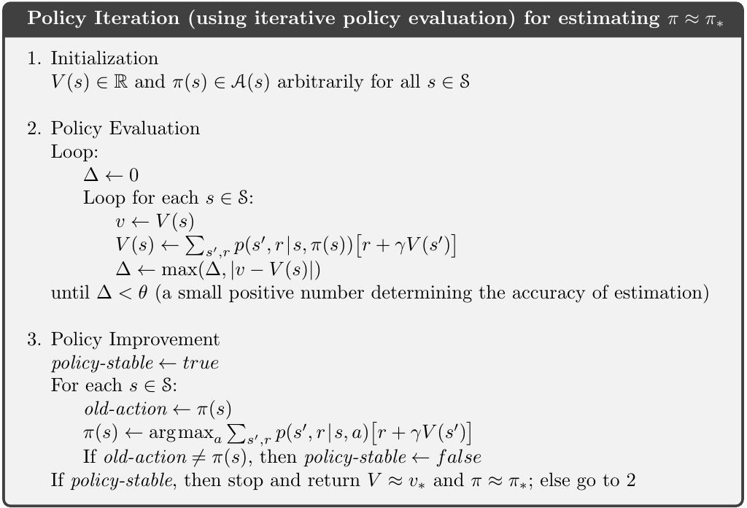
Policy Iteration in Practice
Initialize with for quicker policy evaluation
Often converges in surprisingly few iterations

Slide 15
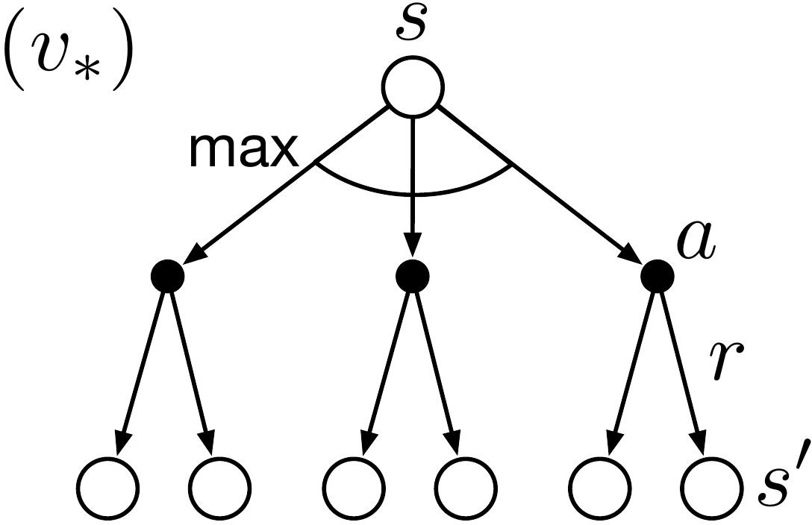
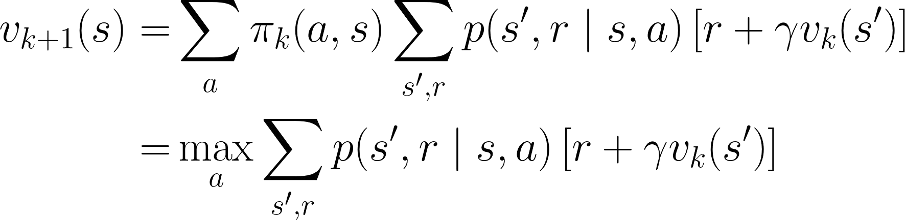
Value Iteration
“Truncate” policy evaluation
Don’t wait until is sufficiently small
Update state values once for each state
Evaluation and improvement can be simplified to one update operation
Bellman optimality equation turned into an update rule

Slide 16
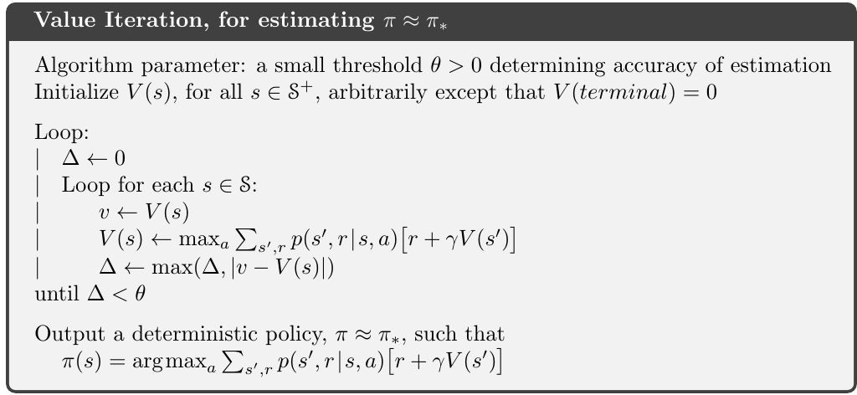
Value Iteration in Practice
Terminate when is sufficiently small

Slide 17
Asynchronous Dynamic Programming
Don’t sweep over the entire state set systematically
Some states are updated multiple times before other state is updated once
Order/skip states to propagate information efficiently
Can intermix with real-time interaction
Update states according to the agent’s experience
Allow focusing updates to relevant states
To converge, all states must be continuously updated

Slide 18
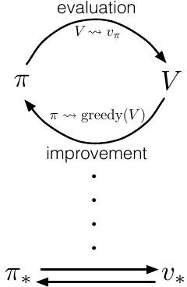
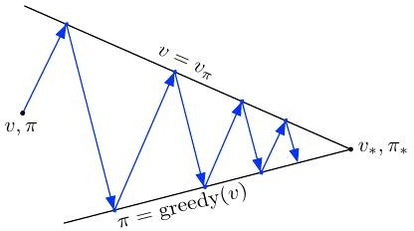
Generalized Policy Iteration
Idea of interaction between policy evaluation and policy improvement
Policy improved w.r.t. value function
Value function updated for new policy
Describes most RL methods
Stabilized process guarantees optimal policy

Slide 19


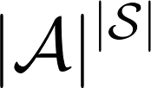
Efficiency of Dynamic Programming
Polynomial in and
Exponentially faster than direct search in policy space
More practical than linear programming methods in larger problems
Asynchronous DP preferred for large state spaces
Typically converge faster than their worst-case guarantee
Initial values can help faster convergence

Slide 20
References
Reinforcement Learning: An Introduction by Sutton and Barto
Reinforcement-learning-an-introduction-chapter-4

